Slide 1


Educational Facilitation System
Final Project Outcomes & Testing
CCIT4080 – Knowledge Product Development · HKU SPACE · CL04 Group 7
Xavier Wong · Kwok Ho Yin · Young Ho Tim
Supervisor: Mr. Lau Chung Yin | April 2026

Slide 2
Outcomes at a Glance
A fully deployed, four-module platform — tested, validated, and live at hku.wiki.
96%
0%
Good/Excellent Rating
k6 Failure Rate
Overall user satisfaction across N=51 survey respondents
Zero failed requests across 5,000 iterations under load
15ms
4
Avg Response Time
Core Modules
p95 at 29ms — well within acceptable performance thresholds
Timetable, Group Formation, Questionnaire Exchange, Materials Repo

Slide 3
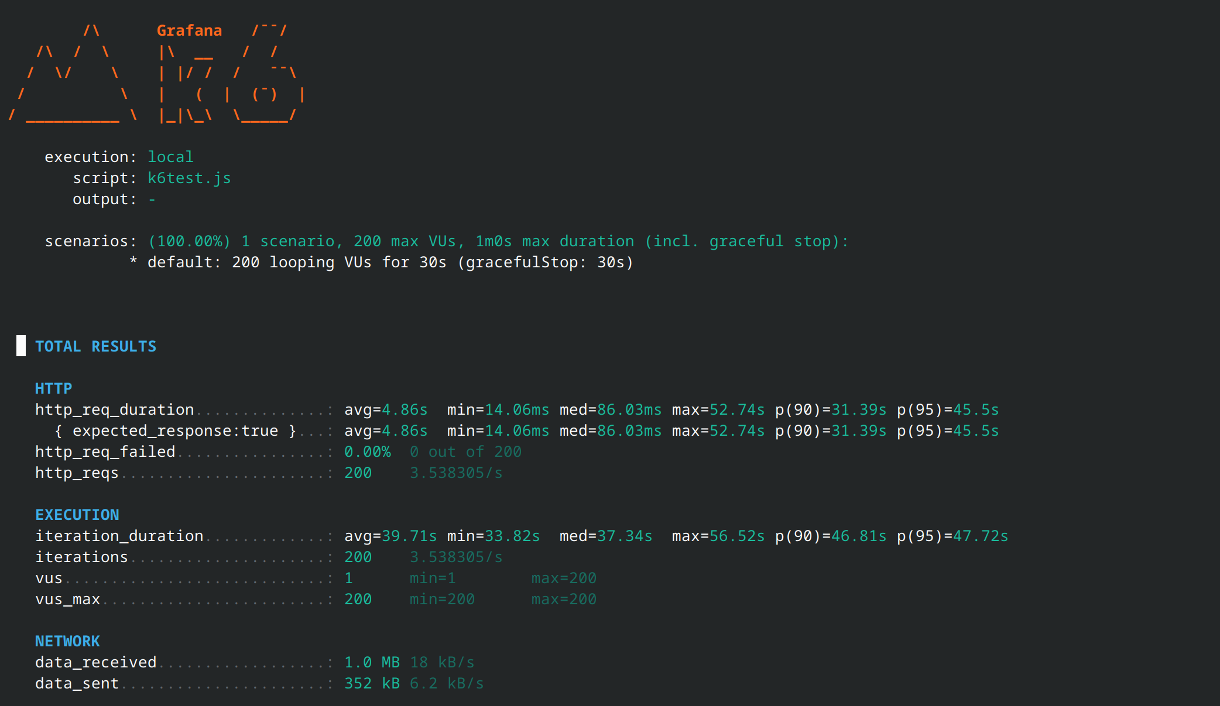
K6 test detail

Slide 4
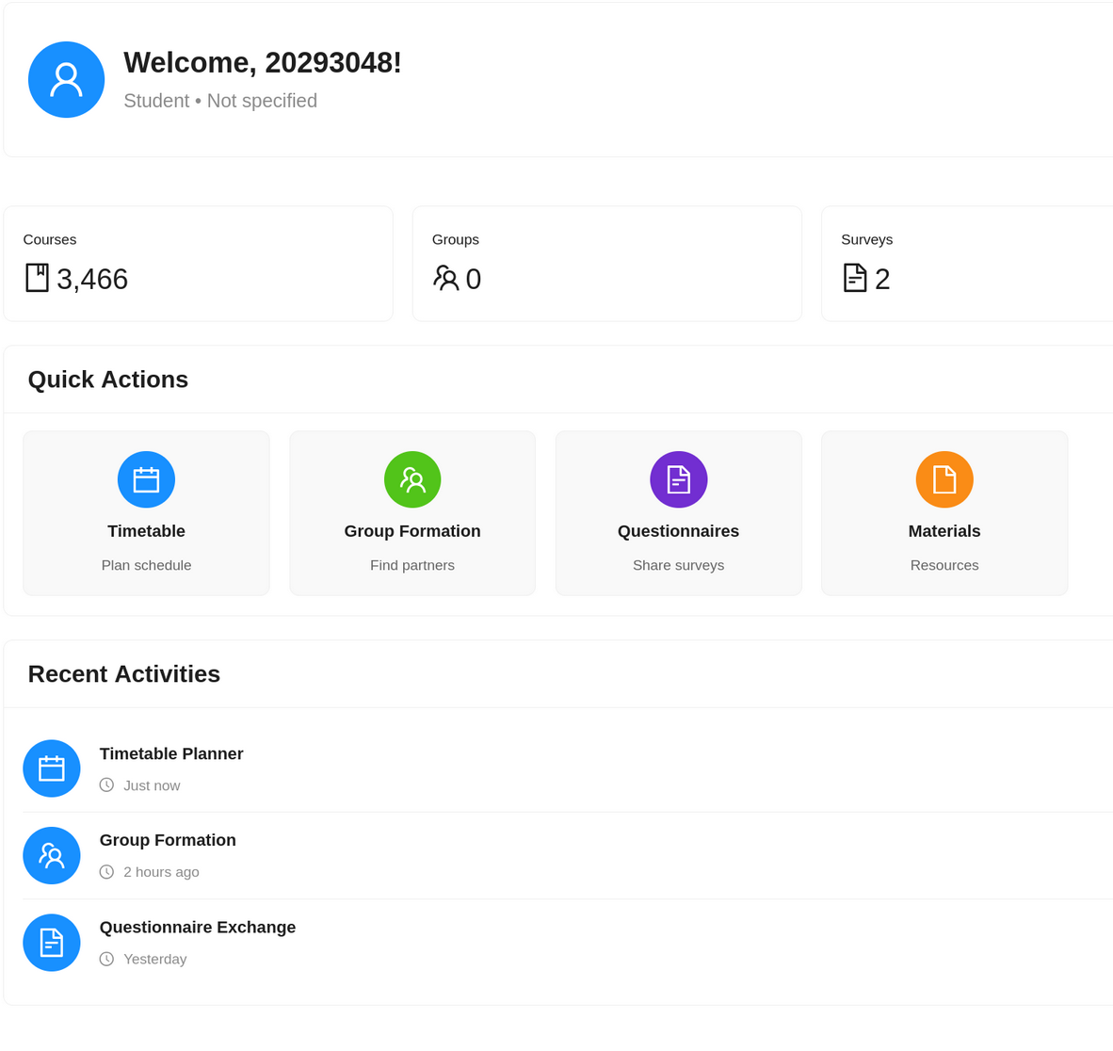
Prototype Status
All four core modules are fully implemented and production-ready.
📅 Timetable Planner
Drag-and-drop scheduling, clash detection, PNG export via html2canvas
👥 Group Formation
Profile matching, email notifications, real-time polling chat
📊 Questionnaire Exchange
Credit system (3 start, +1 fill, -1 post) with unlimited active surveys
📁 Materials Repository
Admin upload, GridFS storage, download tracking for all course files
Plus: Admin dashboard, JWT authentication, and mobile breakpoints at 768px / 1024px.

Slide 5
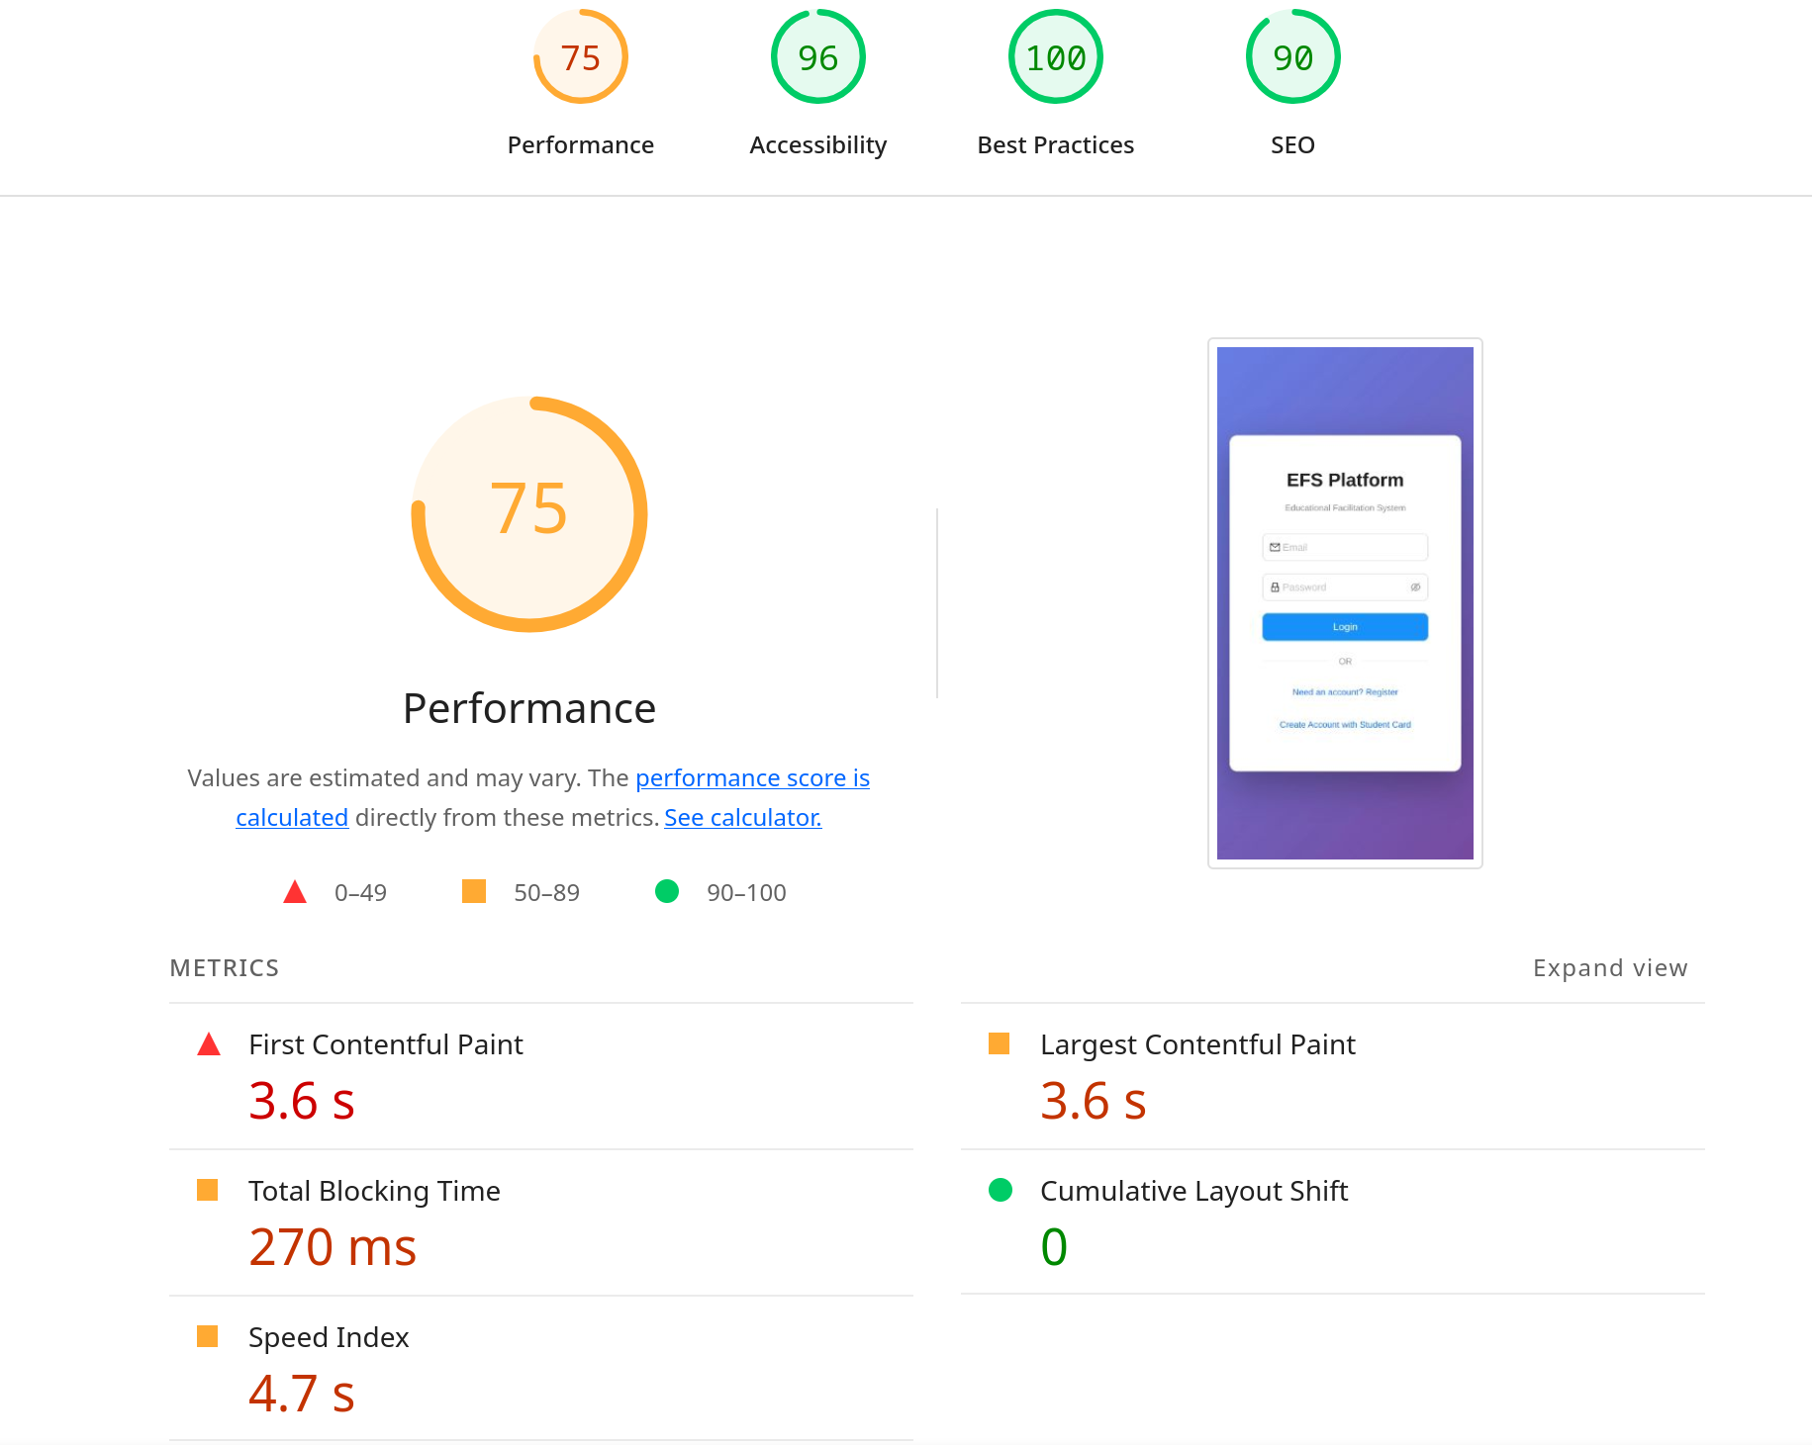
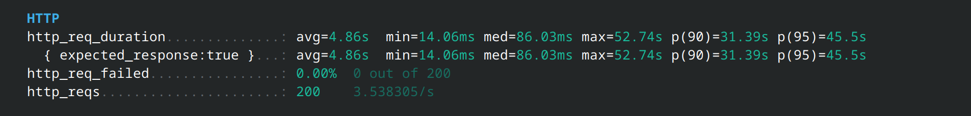
Performance Testing
k6 Load Test
Lighthouse (Mobile)
200 concurrent virtual users sustained over 30 seconds — 5,000 total requests with a 0% failure rate and throughput of 139 kB/s.
75
96
100
90
Optimisations applied: code splitting, 366 KiB of unused JS removed, render-blocking CSS resolved. LCP: 3.6s · CLS: 0 · TBT: 270ms.
15.04ms
29ms
162.7/s
Avg http duration
p95 latency
Iteration rate

Slide 6




User Evaluation (N=51)
A structured survey revealed strong adoption intent and high satisfaction across all platform features.
92%
86%
94%
Found It Useful
Likely to Adopt
Mobile Important
Platform addresses real academic pain points
Would use EFS as part of their regular study routine
Rated mobile design as Important or Very Important
4.53 / 5
85.7%
✨ Qualitative feedback: "faster, efficient", "specialised for HKU SPACE", "convenient, powerful".
Timetable time-saving rating
Demand for past exam papers in Materials Repo
Most valued feature: Timetable Planner (26.5%). Recommended credit starting balance: 3.8 avg — current system uses 3.

Slide 7
Problem Validation
Pre-deployment survey confirmed significant student pain points — all three are measurably improved by EFS.
Reported Pain Points
85%
66%
60%
Manual Timetable Checks
Finding Group Members
Questionnaire Responses
Found PDF-based schedule checking time-consuming
Reported difficulty forming project groups
Struggled to collect 30 responses for EAP II surveys
Post-Deployment Outcomes
91.6%
83.3%
83.3%
79.1%
Agree the Timetable Planner saves time
Find it easier to form groups with EFS
Say the Questionnaire module helps reach 30 responses
Agree the credit system is fair and encourages participation

Slide 8
Key Challenges & Solutions
Every major technical constraint encountered during development was resolved with a targeted engineering solution.
Serverless Constraints
Vercel's serverless model required migrating Express routes to individually exported handler functions.
File Uploads
Multer failed in serverless context — resolved via GridFS streaming and base64 encoding fallback.
MongoDB Connection Limit
Hard cap of 20 connections mitigated using a singleton connection pool capped at 15.
Real-Time Chat (No WebSockets)
Polling implemented at 3s for messages and 5s for group updates as a lightweight alternative.
PNG Timetable Export
html2canvas with manual calibration used to produce accurate, shareable schedule exports.

Slide 9
Future Scope
Based on user feedback, the next iteration will expand functionality and accessibility.
Deadline Reminders
AI Assistant
Dashboard and calendar integration for assignment and exam alerts
Smart FAQ and course recommendation engine powered by LLM
Native Mobile Apps
WebSocket Upgrade
iOS and Android apps with push notifications for real-time updates
Replace polling with WebSockets to reduce chat latency significantly
WCAG 2.1 Level AA
Expanded Materials
Full accessibility compliance + HKU SPACE API integration planned
Past exam papers prioritised — 85.7% of users identified this as top demand

Slide 10
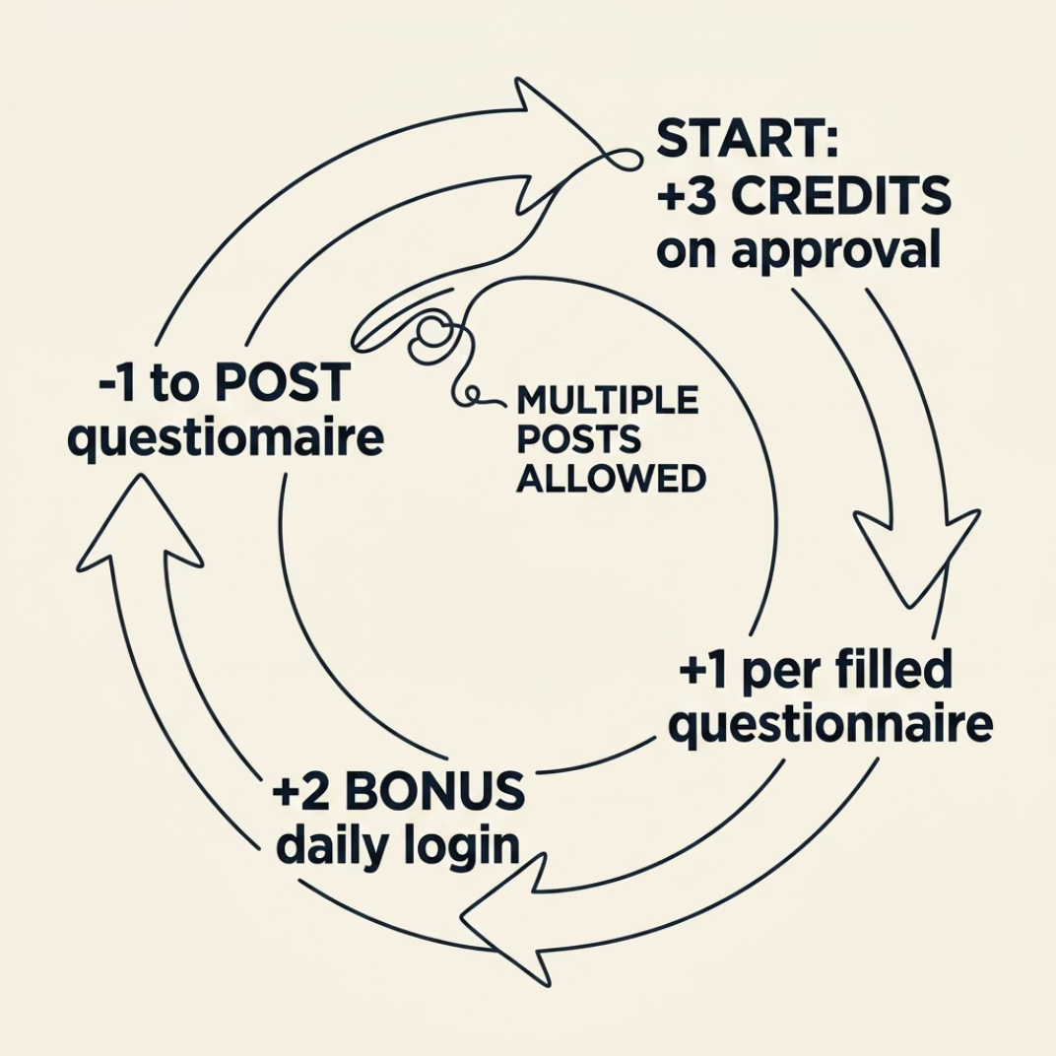


Credit System Deep Dive
A reciprocal credit economy encourages fair participation in the Questionnaire Exchange module.
How It Works
Example: Fill 2 surveys (+2) + daily login (+2) = +4 credits → post up to 4 surveys.
Fairness rating: 4.38/5. Users recommend a 3.8 credit start — current balance may be adjusted in the next iteration.
3 Credits
+1 / +2
−1
Awarded upon admin approval to get started
Earn by filling surveys (+1) or daily first login bonus (+2)
Spent each time you post your own questionnaire

Slide 11
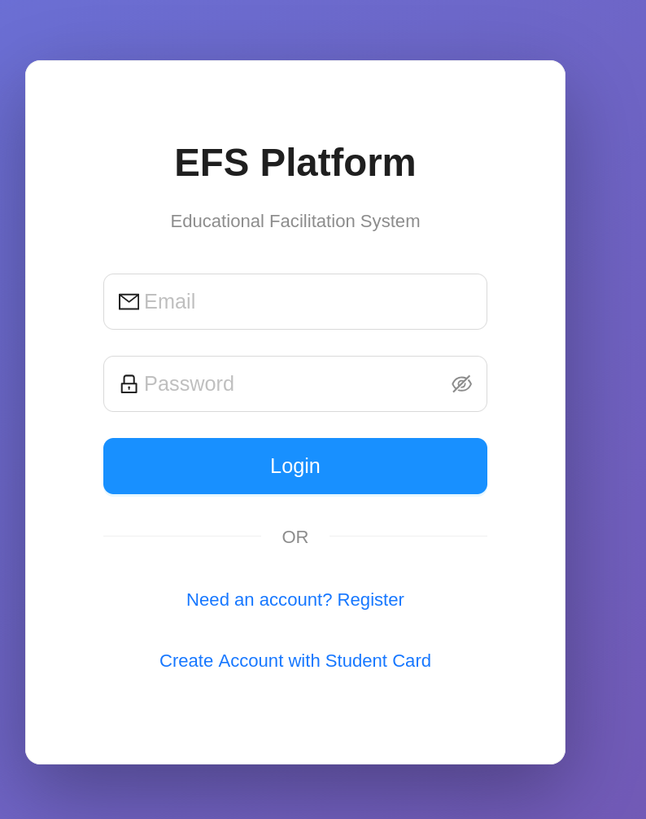
Summary & Conclusion
All objectives met — modules fully implemented, tested, and validated with real users.
✔ Production-Ready
Live at hku.wiki — four modules tackling real academic pain points
✔ High Satisfaction
96% Good/Excellent · 92% useful · 86% likely to adopt
✔ Validated Performance
15ms avg response · 0% failure under 200 VUs · Lighthouse a11y 96
✔ Unique Capabilities
Credit-based exchange, PNG export, real-time chat on serverless infrastructure
🙏 Thank you! Feedback and questions are welcome.
🔗 Live demo: hku.wiki · GitHub: EFS Platform

